Slide 1
Partition-Driven Placement with Simultaneous Level Processing and Global Net Views
K. Zhong and S. Dutt
Department of Electrical Engineering and Computer Science,
University of Illinois at Chicago
Zhong & Dutt, UIC, Nov. 2000

Slide 2
Overview
Problem
Previous Work
New Partition-Driven Placement Algorithm (SPADE)
Experimental Evaluation
Conclusions and Future Work
Zhong & Dutt, UIC, Nov. 2000

Slide 3
Problem
Placement for Deep Sub-Micron (DSM)
  Very large input size (up to tens of millions)
  More optimization objectives (area, delay, power)
  Various heterogeneous constraints (congestion, crosstalk, heat distribution, etc.)
Zhong & Dutt, UIC, Nov. 2000

Slide 4
Major Approaches to Placement
Three mainstream placement approaches
  Partition-Driven Placement (PDP) (e.g. [Breuer, DAC ‘77], [Huang et al, ISPD ‘97])
  Simulated Annealing (SA) (e.g. [Sun et al, TCAD ‘95])
  Mathematical programming (e.g. [Eisenmann et al, DAC ‘98])
Global and detailed placement
  NRG [Wang et al, ICCAD ‘97], Snap-On [Yang et al, ISPD ‘00], etc.
Zhong & Dutt, UIC, Nov. 2000

Slide 5
Advantages of PDP
Time-efficient
  divide-and-conquer approach
Balanced decision with a global view
  top-down placement flow
Can tackle almost any objective function accurately (up to interconnect length model)
  delay, WL, power (in iterative improvement, update cost per move)
Flexibility in tackling multiple constraints
  iterative improvement---check per move
Zhong & Dutt, UIC, Nov. 2000

Slide 6
Previous PDP Work
Sequential level partitioning [Breuer, DAC ‘77]
  regions at the same level are cut sequentially
  may result in sub-optimal wire-length or cutsize
Terminal propagation [Dunlop et al, TCAD ‘85]
  addresses external connections during partitioning
Quadrisection [Suaris et al, TCAS ‘88; Huang et al, ISPD ‘97]
  4-way partitioning better controls wire length in both directions, but run time goes up
Zhong & Dutt, UIC, Nov. 2000

Slide 7
New PDP Techniques--- Rectify Drawbacks of Prior PDP
Placer SPADE (Simultaneous level PArtitioning with Distributed nEt views)
Simultaneous Level Partitioning (SLP)---rectifies prior drawback of sequentially-ordered optimization
Global net views---rectifies prior drawback of localized subcircuit views and cost + inaccuracy of Term. Prop.
Wire-length based gain computation---rectifies prior drawback of mincut-based gain (not strictly WL)
Modified CLIP-FM partitioner [Dutt et al, ICCAD ‘96]
Maximum row length control
Post-processing (cell swaps)
Zhong & Dutt, UIC, Nov. 2000

Slide 8
Simultaneous Level Partitioning
Simultaneous partitioning of all regions within the same level
Cell moves are naturally interleaved across all regions based on gains (as shown in the figure)
Achieves simultaneous optimization across multiple regions
1
2
1
3
4
2
Zhong & Dutt, UIC, Nov. 2000

Slide 9
SLP vs. Sequential Level Partitioning
Sequential level partitioning may not be able to escape local optima
Orig Cost=8
New Cost = 3
New Cost = 1
1
1
v
1
1
v
1
1
v
v
cells
(1)
3
3
3
3
3
u
(1)
u
u
u
u
pads
(2)
4
4
4
4
4
Initial partitioning: nets labeled with weights
Sequential: sub-optimal move sequence, if upper region processed first
SLP: only the cell in lower region moved
Zhong & Dutt, UIC, Nov. 2000

Slide 10
Global Net View vs. Terminal Propagation
Terminal propagation may be inaccurate for wire length reduction
With a global net view we can do better (e.g., moving left is better in the figure shown as it can shrink the BB, while the right move expands BB)
Dummy
Possible moves: dummy position does not help
Zhong & Dutt, UIC, Nov. 2000

Slide 11
De-coupled Regions: a Caveat
Suitable for row-based designs
Property: For a hor. cut, WL change due to cell moves in regions in one side of the previous-level cutline does not affect WL of the subcircuits in regions on the other side
Sequential partitioning of regions separated by previous-level horizontal cutlines justified
Reduced run time at NO cost of wire length
c
d
c’
Two segments can be shrunk separately; Regions spanning cutline c is de-coupled from those spanning c’ by previous cutline d
Zhong & Dutt, UIC, Nov. 2000

Slide 12
Wire-length Based Gain
Pin coordinates (x or y) of each net along the direction orthogonal to current cutline are stored in a binary search tree
SPADE-FM: A cell move can have non-zero gain only when it changes global bounding-boxes of connected nets
Zhong & Dutt, UIC, Nov. 2000

Slide 13
Illustration of Gain Computation
u
v
u
g(v)=5L
d
x
3L
d'
8L
d''
w
d
SPADE-FM: gain(u) = gain(w) = 0; since neither move can change bounding box by itself; only gain(v)=5L is positive and all others have gain zero as “internal” nodes.
SPADE-PROP: gain(u) = (d'-d)•p(u)•p(w)/p(u) + (d'' - d')•p(x), where p(y) is the probability of y. The gain is of two parts: single-step PROP gain of moving u and w, and multi-step gain for moving cells not on the boundary of BB (e.g., x) from same side as u.
Zhong & Dutt, UIC, Nov. 2000

Slide 14
Global Gain Update
cell move
Every move may entail out-of-region update of cell gains
Total time taken for such update per pass is bounded by O(p*log(p)), where p is the pin number
1
0
0
1
Gain update needed
Zhong & Dutt, UIC, Nov. 2000

Slide 15
Maximum Row Length Control
A decisive factor in die-area utilization
Gradually increase row-balance deviations w/ partitioning tree levels to max allowable
  cannot use the prescribed max. row-length devn, as it can freeze moves for future cuts (see figure below)
Devn
avail.
Initial devn set as max allowed value
Max devn reached, further partitioning badly hampered
Row devn assigned inversely proportional to logarithm of # of rows of target regions
Zhong & Dutt, UIC, Nov. 2000

Slide 16

Local Region Balance Control
Relaxed local balance but strict row-balance control
A
B
A
B
C
D
C
D
Local Deviation (from closest possible balance to 50-50) = Row Deviation overconstrains the problem
Allow Local Deviation = α(Row Deviation), α > 1, but maintain overall row deviation
Zhong & Dutt, UIC, Nov. 2000

Slide 17
Circuit Partitioning Engine
CLIP-FM variation (SHRINK-FM) or SHRINK-PROP algorithm at the core
  shrinking initial gain helps cluster removal
  iterative mode: shrink factor gradually enlarged to get independent gains after most clusters are removed through earlier passes
Two-level gain tree structure
  local binary search tree for each region
  top-gain cells of local trees sorted into global tree
Efficient global cell selection strategy
  row-balance violation: search opposite global tree
  local violation: switch to opposite local tree
  tie-breaking: following latest move
Zhong & Dutt, UIC, Nov. 2000

Slide 18
Post-processing
Intra-row horizontal neighbor swap
Intra-row clustering based on int/ext nets ratio
Inter-row vertical swap
  some cells have to be shifted due to cell overlap
Results in about 1-2% improvement
Horizontal neighbor swap
Vertical cell swap
Zhong & Dutt, UIC, Nov. 2000

Slide 19
Experimental Evaluation
MCNC standard cell benchmarks: up to 100k cells
Compared with prior methods
  TimberWolf 7.0 [Sun et al, TCAD ‘95]
  FD-98 [Eisenmann et al, DAC ‘98]
  QUAD [Huang et al, ISPD ‘97]
  Snap-On [Yang et al, ISPD ‘00]
Same number of rows as TimberWolf 7.0
Part of IBM-PLACE circuits also tested (ibm11 - ibm15) and compared to iTools [internetCAD]
Experiments conducted on 550 MHz Pentium-III Linux workstations
Zhong & Dutt, UIC, Nov. 2000

Slide 20
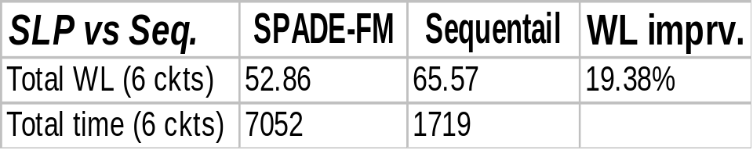
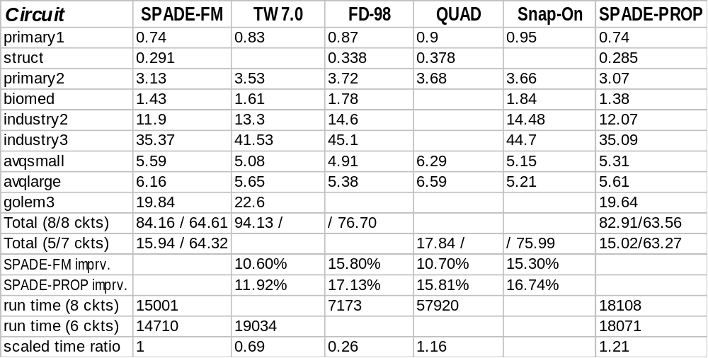
Comparison with Previous Methods
Zhong & Dutt, UIC, Nov. 2000

Slide 21
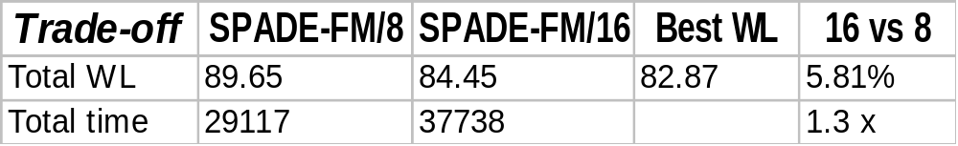
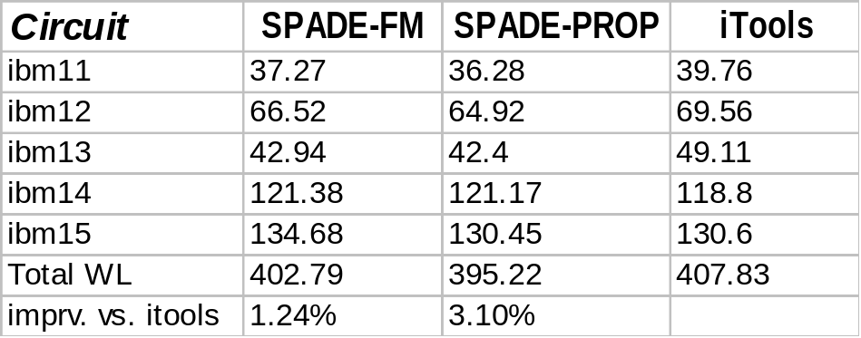
Results for IBM-PLACE Benchmarks
Other Experimental Results
Trade-off between run time and solution quality of SPADE-FM with 8 and 16 runs for the MCNC suite
Zhong & Dutt, UIC, Nov. 2000

Slide 22
Conclusions and Future Work
Introduced novel concepts of:
  SLP
  global net view
  bounding-box based gain computation
PDP alone can be competitive (in fact better)
  up to 15.8% better in aggregate result than s-of-art
  among large circuits:
    best-known result for largest MCNC ckt - golem3
    best-known results for ibm11-ibm13
Run time reasonable, but can be reduced
  early-stop per pass
  multilevel clustering
On-going work
  timing-driven PDP
  multi-constraint PDP (congestion, thermal distr, mult obj)
Zhong & Dutt, UIC, Nov. 2000

